Slide 1

Java 11
New features

Slide 2
Upgrading from Java 8 sounds scary

Slide 3

Upgrading from Java 8 sounds scary
Super happy with java 8, thanks!

Slide 4
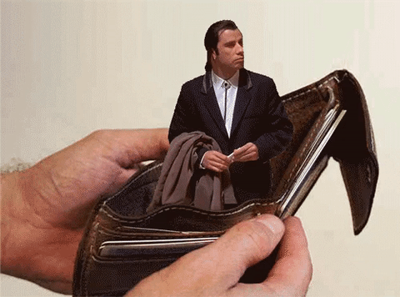
Upgrading from Java 8 sounds scary
I don’t want to pay for java

Slide 5
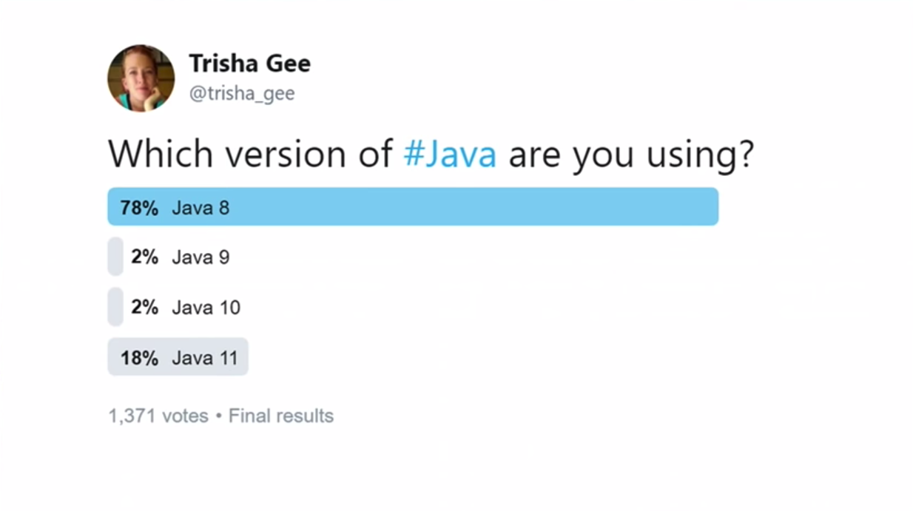

Slide 6

Releases & Updates

Slide 7
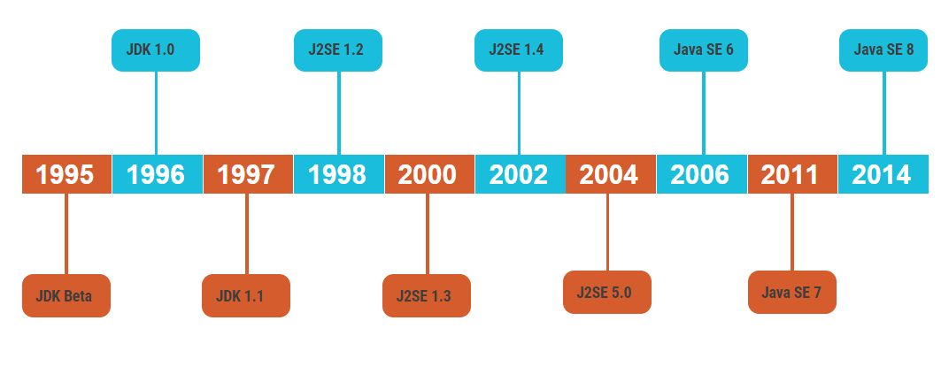
Releases until JAVA 8

Slide 8
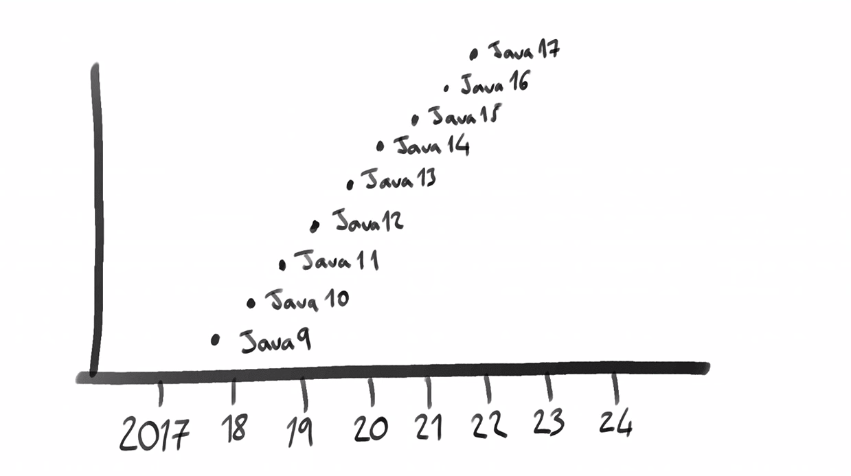
Releases after JAVA 8 (Releses of JAVA every six months)

Slide 9
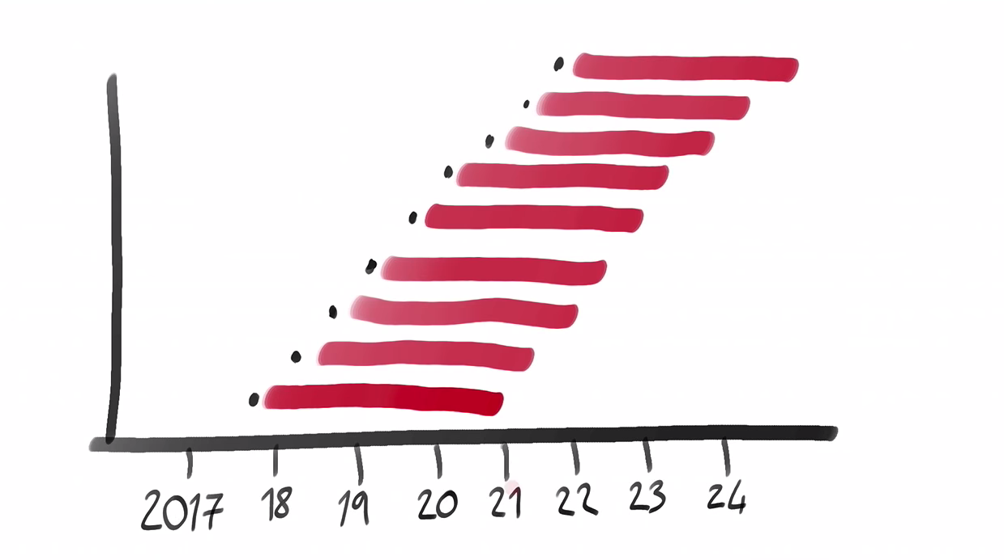
Releases after JAVA 8

Slide 10
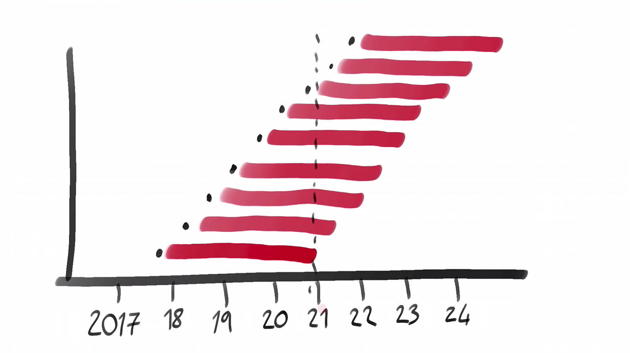
Releases after JAVA 8

Slide 11
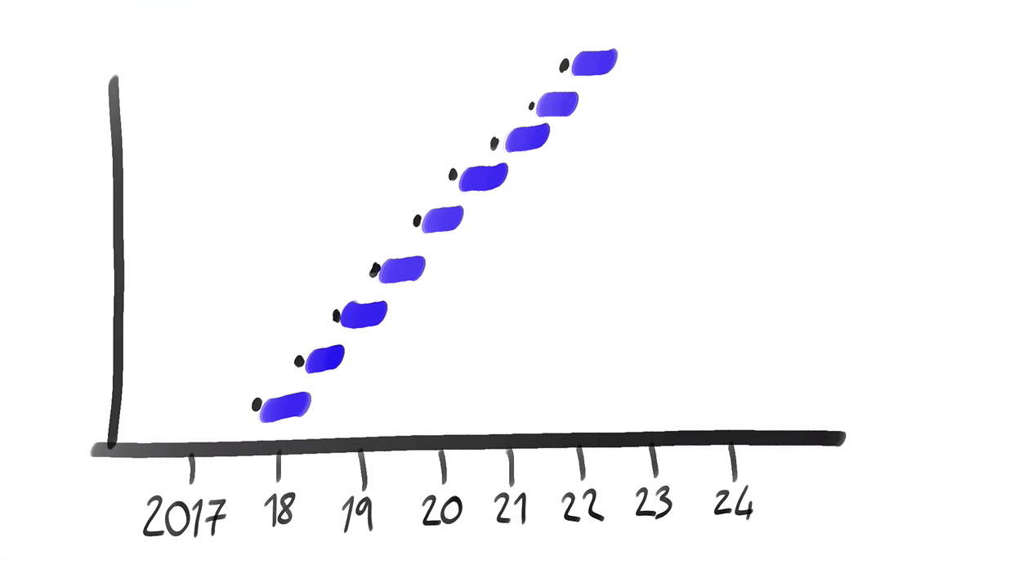
Releases after JAVA 8 – supporting and updating

Slide 12
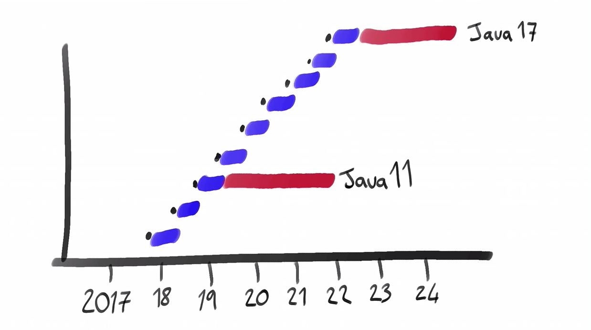
Releases after JAVA 8
-> Interim Releases -> LTS (Long term support) releases

Slide 13
Licensing

Slide 14
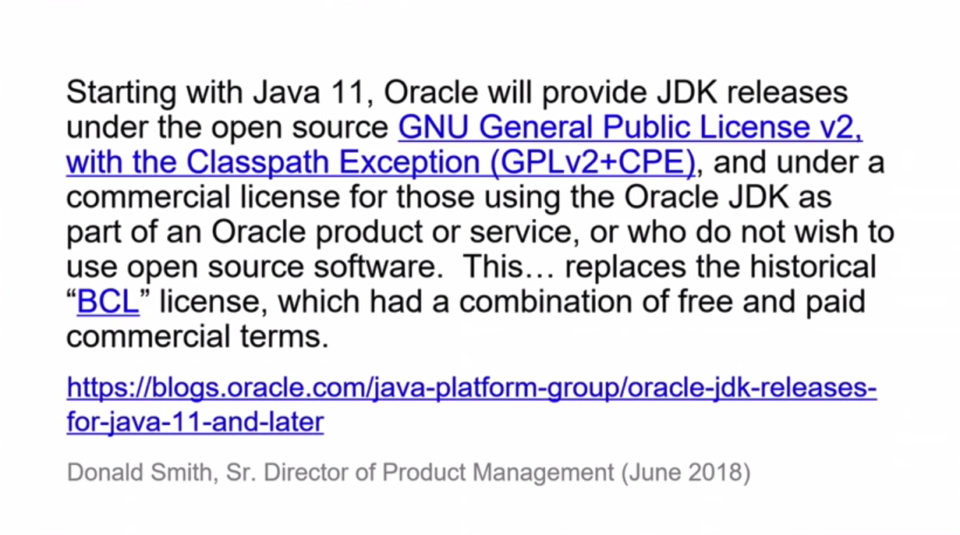
Licensing

Slide 15

That sounds overly complicated. Talk us through it.

Slide 16



Versions
Commercial
Free
Oracle JDK
But you have to pay to use it in production
OpenJDK
But will be replaced every 6 months

Slide 17
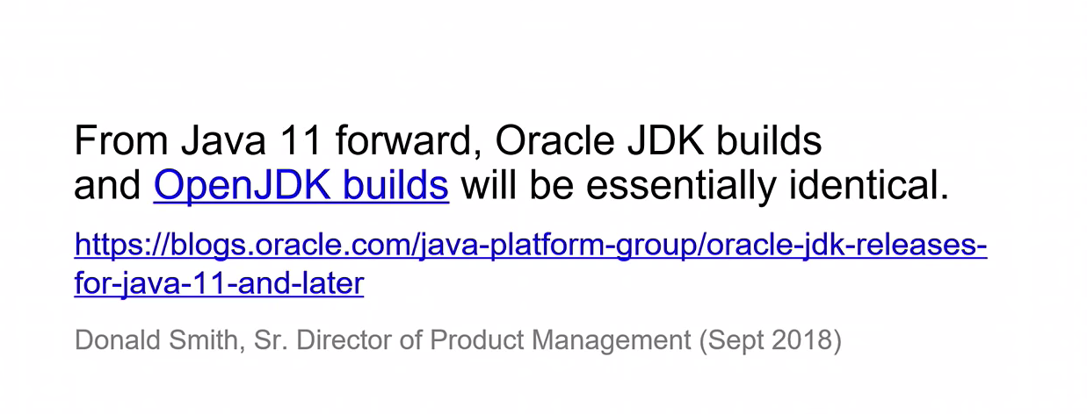
Licensing

Slide 18
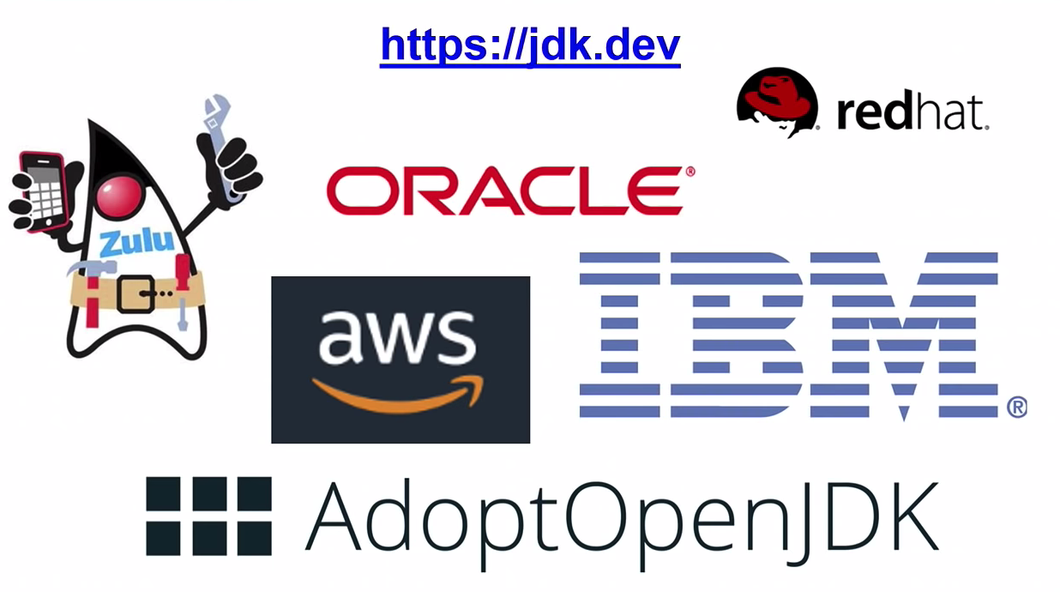
Licensing JDK vendors

Slide 19

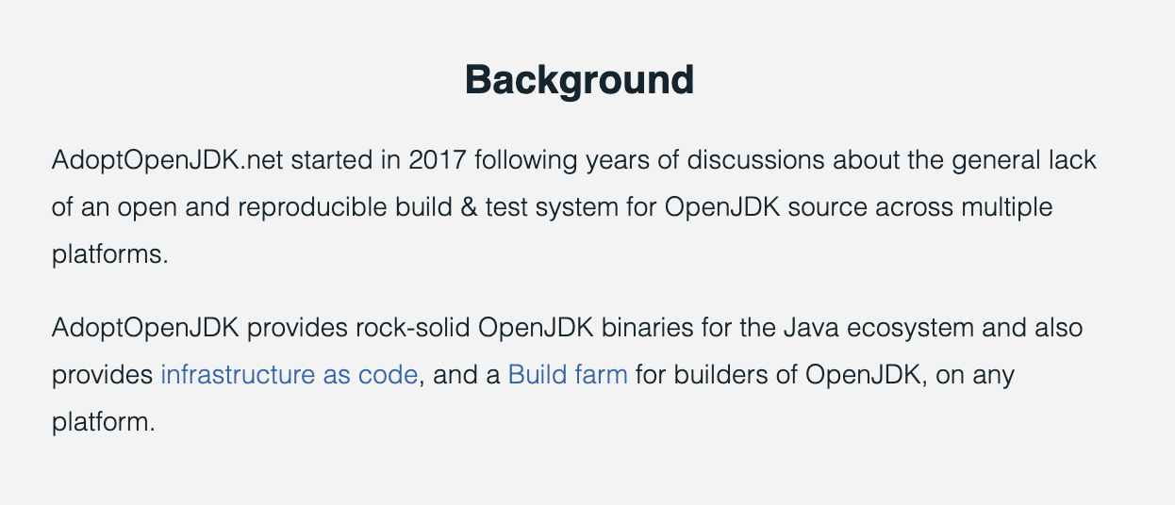
Licensing

Slide 20
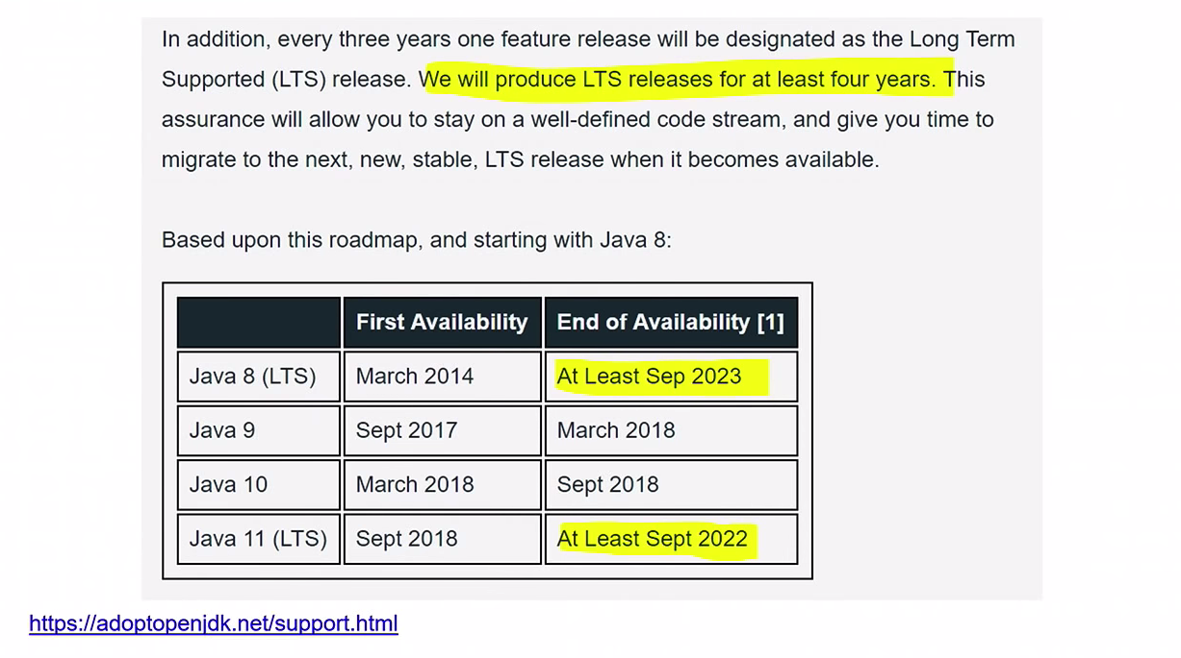
Licensing

Slide 21

Some of the new features from JAVA 11
Show me the code

Slide 22
Some New Features from JAVA 11
Jshell
VAR
Collection factories
list.of
Map.of
Stream
Optional
File methods
String methods
Switch expressions(12)
Show me the code

Slide 23
Onboarding JAVA 11 on Sbil projects
Pull Request 10187: Merge feature/SP09/6705545-java11-groups-onboarding to release/FY20-0802
Show me the code

Slide 24

Thanks, and happy coding!
Show me the code

